Slide 1

Excel in the Accounting Curriculum – Where and How
Debby Bloom, CMA, CFM, CSCA
Accounting Instructor
Reading Area Community College
Reading, PA

Slide 2
Where in the Accounting Curriculum?
Principles of Accounting/Intermediate
Accounts Receivable
Pivot tables, sorting, subtotals, filters
Investments
Date functions, counting days using Excel, interest earned, future value
Fixed assets and depreciation
Depreciation tables and charts

Slide 3
Where in the Accounting Curriculum?
Principles of Accounting/Intermediate
Long term liabilities and bonds
Amortize leases
installment loans and bonds using interest method
present value calculations
Comparative financial statements

Slide 4
Where in the Accounting Curriculum?
Cost/Managerial Accounting
Cost Behavior
Introduction to data, sorting and high/low, regression analysis, scatter charts
Flexible Budgeting
Relative and absolute cell references, scenario manager

Slide 5
Where in the Accounting Curriculum?
Cost/Managerial Accounting (continued)
Capital Budgeting
Time value of money, NPV and IRR functions in Excel
CVP Analysis
What if analysis, goal seek

Slide 6
Where in the Accounting Curriculum?
Other courses
Cost Accounting covers many of the same topics as Managerial Accounting
Process costing and templates
Auditing – use Excel’s statistical package
Advanced Accounting – use Excel for consolidations and partnership liquidations

Slide 7
Where in the Accounting Curriculum
Dedicated course in Excel for Accounting
Solve specific accounting problems
Time value of money
CVP analysis
Flexible budgeting
Common-size balance sheet and income statement
Sample syllabus included

Slide 8
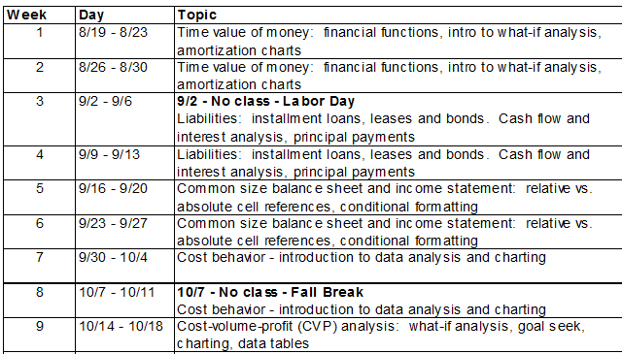
Sample Syllabus for Excel and Accounting

Slide 9
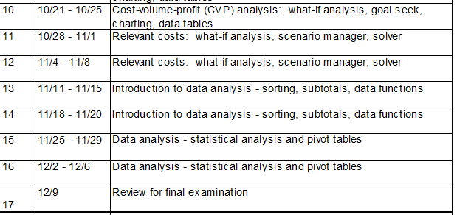
Sample Syllabus for Excel and Accounting

Slide 10
How to Add Excel
Ask to move the class to a computer lab for the semester or selected days
Complete homework problems using Excel
Add assignments using Excel
Give video instructions
Post screenshots of instructions
Post links to instructional videos

Slide 11
How to Lead the Class in the Lab
Be prepared with a list of all commands and data you will be using in class
It is very easy to lose your place
Set out a plan at the beginning of class
Example – today we will learn how to create an amortization chart using if statements and the fill handle

Slide 12
How to Lead the Class in the Lab
I do every command on the overhead projector and expect the class to follow along
You can use the zoom in the bottom right-hand corner to show individual formulas without messing up your column widths

Slide 13
How to Lead the Class in the Tab
Walk around the class every 3 or 4 commands
Make sure students are not too far behind
Make sure students are not doing other work
I kick students out of the lab who are not participating
Lab time is a privilege

Slide 14
How to Lead the Class in the Lab
Minimize the amount of typing students need to do
Give students plenty of time
Post files with column headers and row headers already typed, data already filled in
Files can be posted to Canvas (or your institution’s LMS), to a network drive, or a file sharing system such as Google Docs

Slide 15
How to Lead the Class in the Lab
Go very slowly at the beginning of the semester
Topics like time value of money or CVP analysis use simple formulas and functions
Try to cover topics in the lab right after the traditional lecture
Reinforces the topic

Slide 16
Other Classroom Tips
You will have some students who already know Excel
Enlist them to help other students during the lab
Encourage students to bring jump drives to save their work
If they forget, they can email their files to themselves once the lab is completed

Slide 17
Useful Tip
You can show a formula by double clicking on the cell
You can show all your formulas by holding down the control key at the same time as the tilde (~) key (to the left of the number 1 on the keyboard)
You can get back to your regular worksheet by holding down the control key and the tilde again. Your column widths will not be changed.

Slide 18
Don’t Get Sidetracked
If a student asks a question about a related function or formula, do not get sidetracked
It is very easy to lose your place
Some students will follow you, some won’t
You will not get back to where you were before
If you are intrigued or need to answer the question
Copy your worksheet, urge students not to follow
Get back to your place on original worksheet

Slide 19
Relax
Don’t worry if you are not an excel expert
Your area of expertise is solving accounting problems with Excel
With adequate preparation you will be relaxed when you lead the class
If students have questions you can’t answer, tell them you will look it up

Slide 20
What I Have Provided
Click the link below for the presentation and folders with Word files that show step by step instructions with screen shots, along with excel data files to go along with the Word files
https://debbybloomhill.com/TACTYC2025/tactyc25page.htm
You can also find it at www.debbybloomhill.com by clicking the link Click here for TACTYC 2025 Annual Meeting Files

Slide 21

What I Have Provided
QR Code for website

Slide 22
Contact Me
Questions or comments?
dbloomhill@hotmail.com
YouTube channel
https://www.youtube.com/@debbybloom-hill3459

